Slide 1
FEDERATED LEARNING Decentralizing Machine Learning
Wilson Valdez Solís
wilson@inf.u-szeged.hu

Slide 2
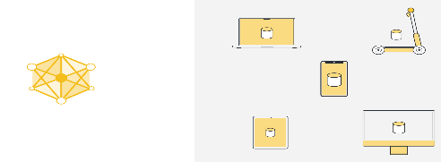
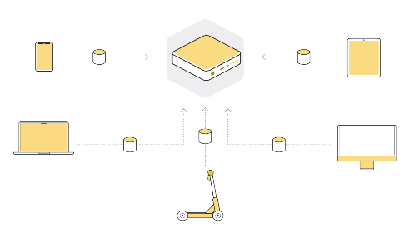
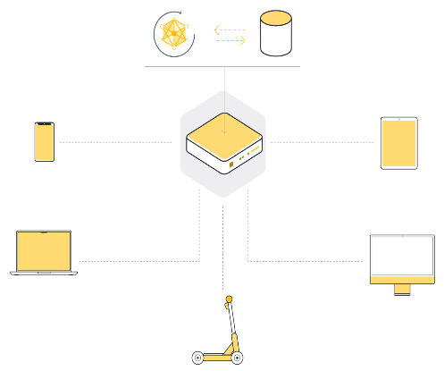
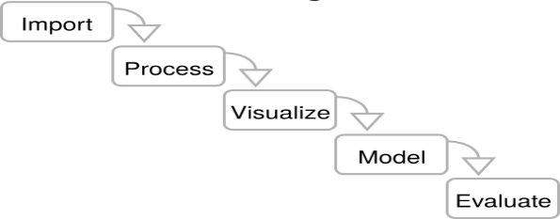
Background
The classic Machine Learning (ML)
In ML we have
Train the model using data to perform specific tasks.
But data does not originates in the machine we train the model.
1
2
3
Train Model
Model
Data
From Somewhere else
Phone Car Laptop Smart Speaker
……
Somewhere else usually is not just one place but several
Data must be collected in one place, a server (local or cloud)
Once Data is collected then we can train the model.
4
5
6
WORKFLOW

Slide 3
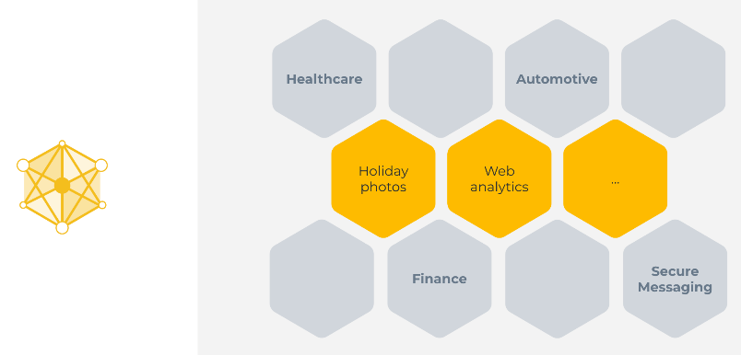
Challenges of classical ML
However, this approach can´t been used in large number of cases where data is not available on a centralized server, or cases where data available on one server is not enough to train a good model.
2
ML can be seen in some simple or complex cases such as: detect objects, transcribe an audio to text, or categorizing photos, analyzing web traffic
1
Main reasons why the classic ML does not work for large amount of cases:
Regulations. Data governed by different data protection regulations.
User preference. User expect their data does not leave their devices.
Data volume. Some data sources produce high volume of data (sometimes not useful) to transmit and store in new places.
Examples where centralized machine learning does not work:
Health records from multiple hospitals, to train cancer models
Financial information from different organizations, to detect fraud
End-to-end encrypted messages to train auto-complete models

Slide 4
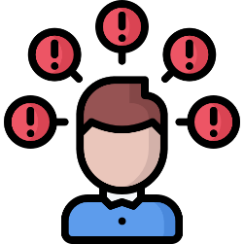
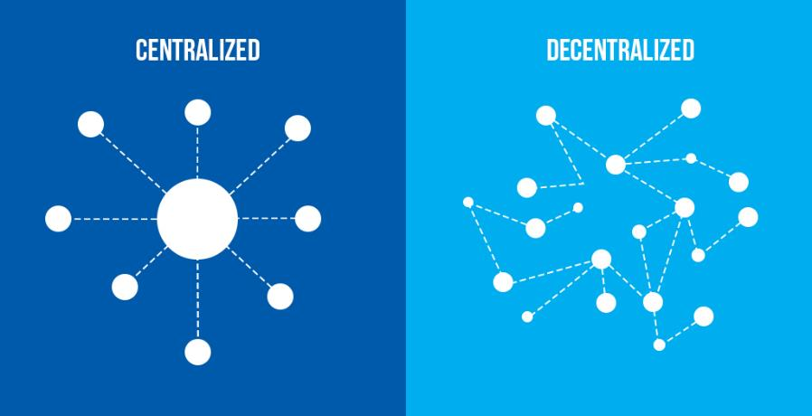
Background
Problems?
All in One, One in All
Let´s Decentralize!!
Let’s Federate!!

Slide 5
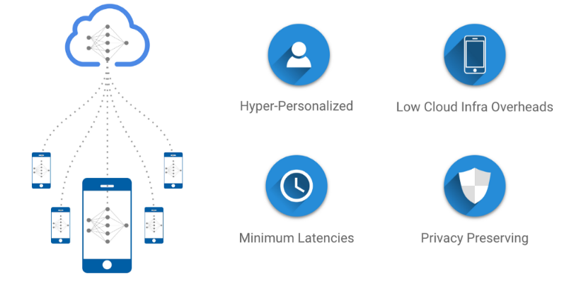
Federated Learning (FL)
FL was first introduced by Google in 2016 as a way to train machine learning models on decentralized data sources while maintaining data privacy.
Central Machine Learning. move the data to the computation.
Federated Learning. move the computation to the data
Multiple devices to collaboratively train a model while keeping the data decentralized and private.
The model is trained locally on each device, and the local models are combined to update the global model.
Therefore, more and more areas that can suddenly be reinvented because they now have access to vast amounts of previously inaccessible data.

Slide 6
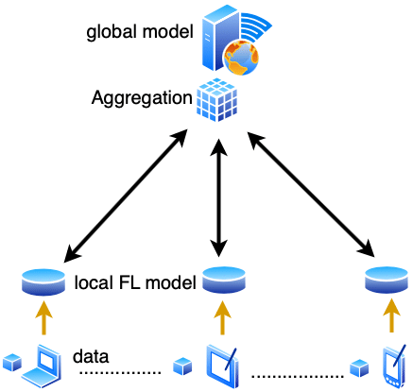
Main Components
The process of combining the local models trained on the clients to update the global model.
Aggregation
Server
Data
Communication Protocol
Clients
Model
The model is initialized on the server and is trained locally on the clients
Responsible for coordinating the FL process. It aggregates the models trained on the clients and updates the global model
The data remains on the clients and is not shared with the server or other clients
Enables the server and clients to exchange model updates and other information.
smartphones, tablets, IoT devices, or other computing devices

Slide 7
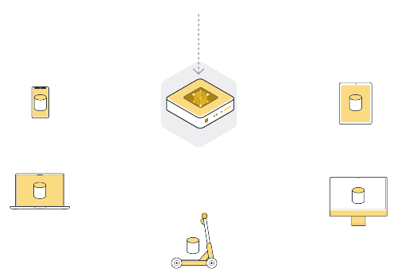
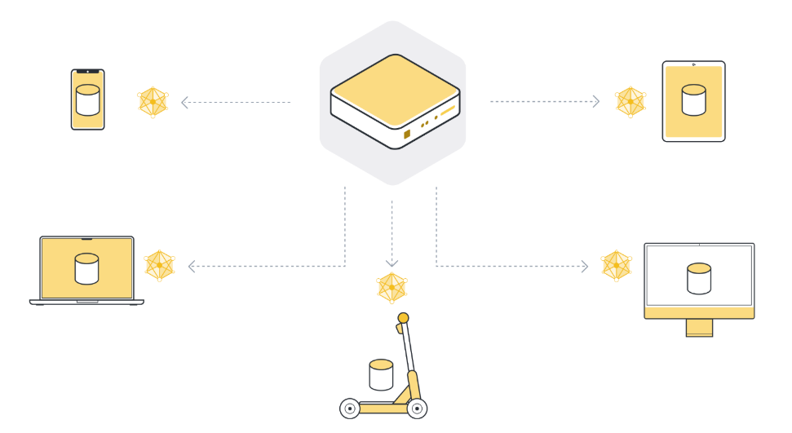
Main Components
FL in 5+1 Steps
Initialize the global model.
Send model to a number of connected organizations/devices (client nodes).
1
2
Initialize the model parameters, either randomly or from a previously saved checkpoint.
Send the parameters of the global model to the connected client nodes to perform the local training using the same model parameters.
It often use only a few of the connected nodes instead of all nodes. .

Slide 8
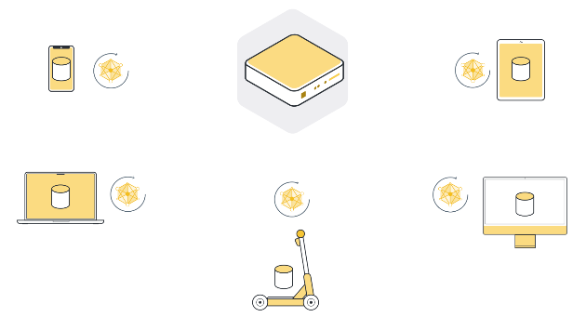
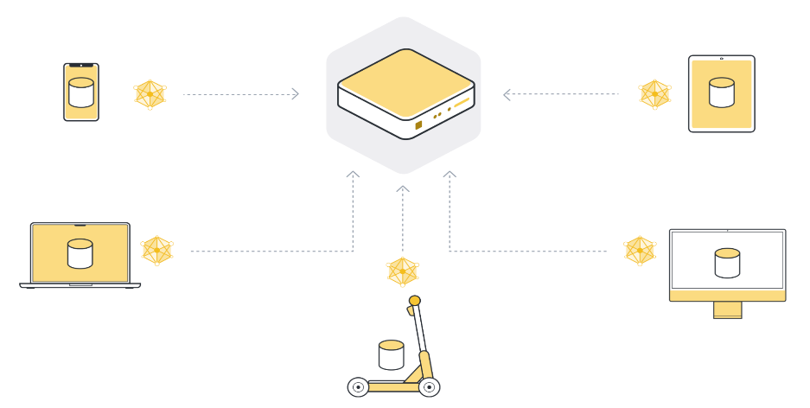
Main Components
FL in 5+1 Steps
Train model locally on the data of each organization/device (client node).
Return model updates back to the server.
3
4
Once the client nodes have the latest version of the global model parameters, they start the local training.
They use their own local dataset to train their own local model.
Each client node has a slightly different version of the model parameters they originally received. The parameters are all different because each client node has different examples in its local dataset. The client nodes then send those model updates back to the server.

Slide 9
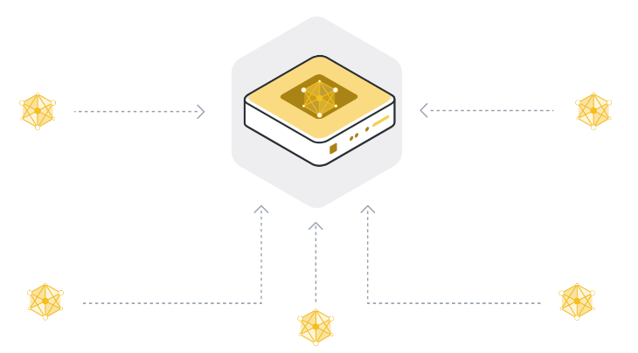
Main Components
FL in 5+1 Steps
Aggregate model updates into a new global model.
5
Aggregation: combine all the model updates received from the client nodes.
The most basic way to do it is called Federated Averaging, often abbreviated as FedAvg (it takes the 100 model updates and, as the name suggests, averages them).
+1
Repeat steps 2 to 5 until the model converges.
Repeat this process over and over again to eventually arrive at a fully trained model that performs well across the data of all client nodes

Slide 10
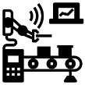
Application
Fields
Healthcare | Train machine learning models on sensitive medical data that is distributed across various hospitals and clinics. This allows researchers to leverage a vast amount of data while maintaining patient privacy.
Finance | Train fraud detection models using data from multiple banks while preserving the privacy of individual customers
IIoT | Train models on data collected from various IoT devices, allowing for more accurate predictions and better decision-making.
Agriculture | Train models on data collected from various sensors in crops and livestock, improving crop yields and animal health.
Telecoms | Train models on data collected from various devices and networks, improving network performance and customer experience.
Smart Cities | Train models on data collected from various sensors in the city, allowing for better traffic management, energy efficiency, and .environmental monitoring
Improve the efficiency and accuracy of machine learning models while maintaining data privacy and security.

Slide 11
Challenges
Heterogeneous devices |  | The devices used for training the model are heterogeneous (different hardware specifications, operating systems, and software configurations). This can make it challenging to design a model that performs well across all devices.
Data Privacy |  | Since the data is stored locally on each device, there is a risk of data leaks or gaps.
Communication overhead |  | FL requires communication between the devices and the central server. This communication can be challenging, especially when dealing with a large number of devices or slow network connections
Unreliable devices |  | Some devices in a FL setup may be unreliable, leading to issues with training and model accuracy.
Model heterogeneity |  | In FL, different devices may have different versions of the model. This can lead to issues with model aggregation, which is the process of combining the different versions of the model into a single model.
Resource constrains |  | FL requires a significant amount of computational resources, which may be a challenge for devices with limited computing power or storage capacity.

Slide 12
Conclusions
FL is promising machine learning technique that enables multiple devices to train a model collaboratively while keeping the data private and secure.
FL emergence has been driven by the need for privacy and security in machine learning and the desire to enable machine learning on decentralized data sources.
FL has gained significant attention from researchers and practitioners in the machine learning community, and several companies have implemented it in their products and services.
FL has also sparked research into new privacy-preserving techniques, such as differential privacy, secure aggregation, and homomorphic encryption.

